Slide 1
Computer Networks
Gu Qing, Xia Nai
Nanjing University
2011-9-13

Slide 2
Chapter 3. Packet Switching Networks
Switching and Forwarding
Virtual Circuit and Datagram Networks
Routing
ATM and Cell Switching
X.25 and Frame Relay

Slide 3
Switching and Forwarding
OSI network-layer functions
Switching / Routing
Determine route taken by packets from source to destination
Shortest path from source to destination
Forwarding
Move packets from input to designated output determined by switching
Error handling, queuing and scheduling
Notes:
All belongs to switch or router

Slide 4
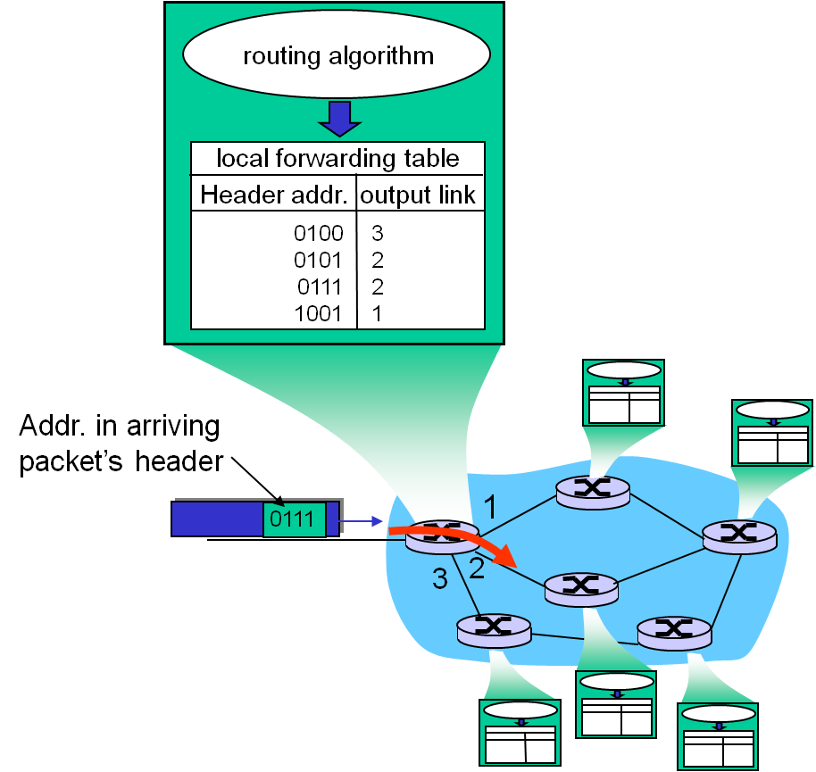
Switch Functions
Routing determines the forwarding table

Slide 5

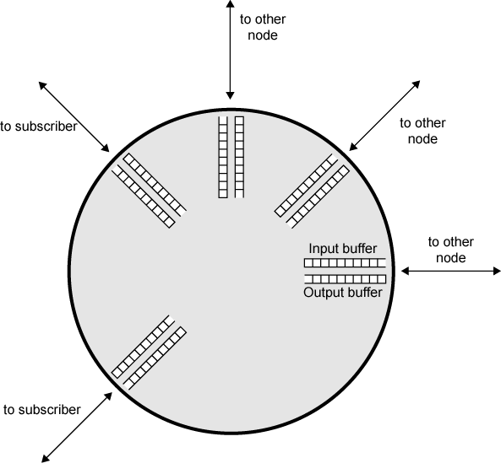
Forwarding Functions
Queuing and scheduling
Host to Switch
Switch to Host
Switch to Switch

Slide 6
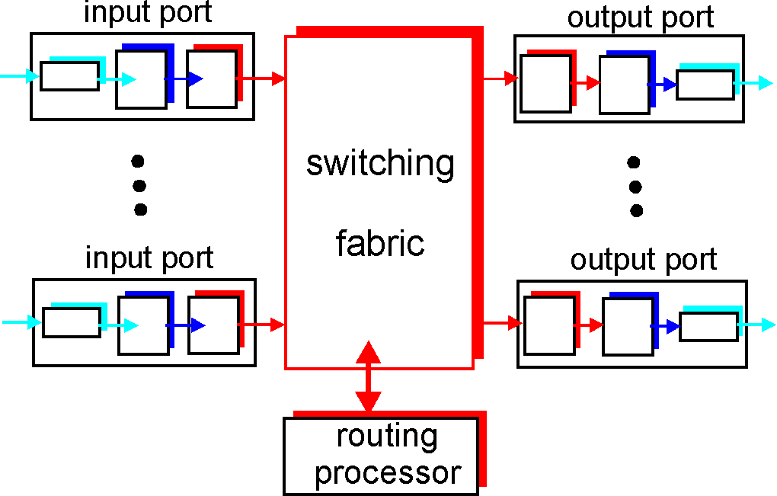
Inside a Switch
Two key switch functions:
Run routing algorithms/protocol
Forwarding packets from incoming to outgoing link

Slide 7
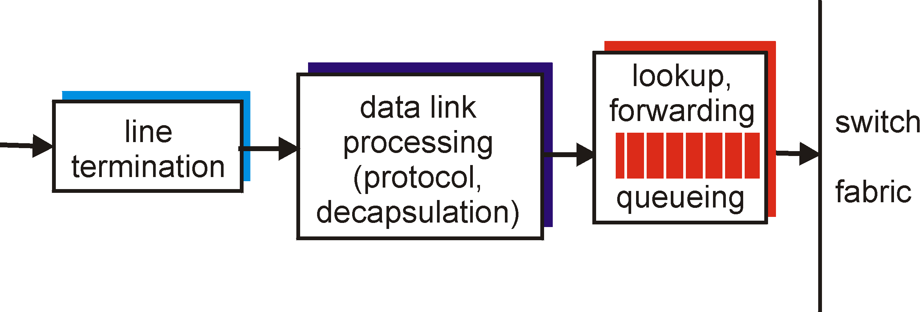
Input Port Functions
Physical layer:
Bit-level reception
Data link layer:
Error handling
Decentralized switching
Lookup output port using forwarding table
Complete input port processing at “line speed”
Queuing: if packets arrive faster than forwarding rate into switch fabric

Slide 8
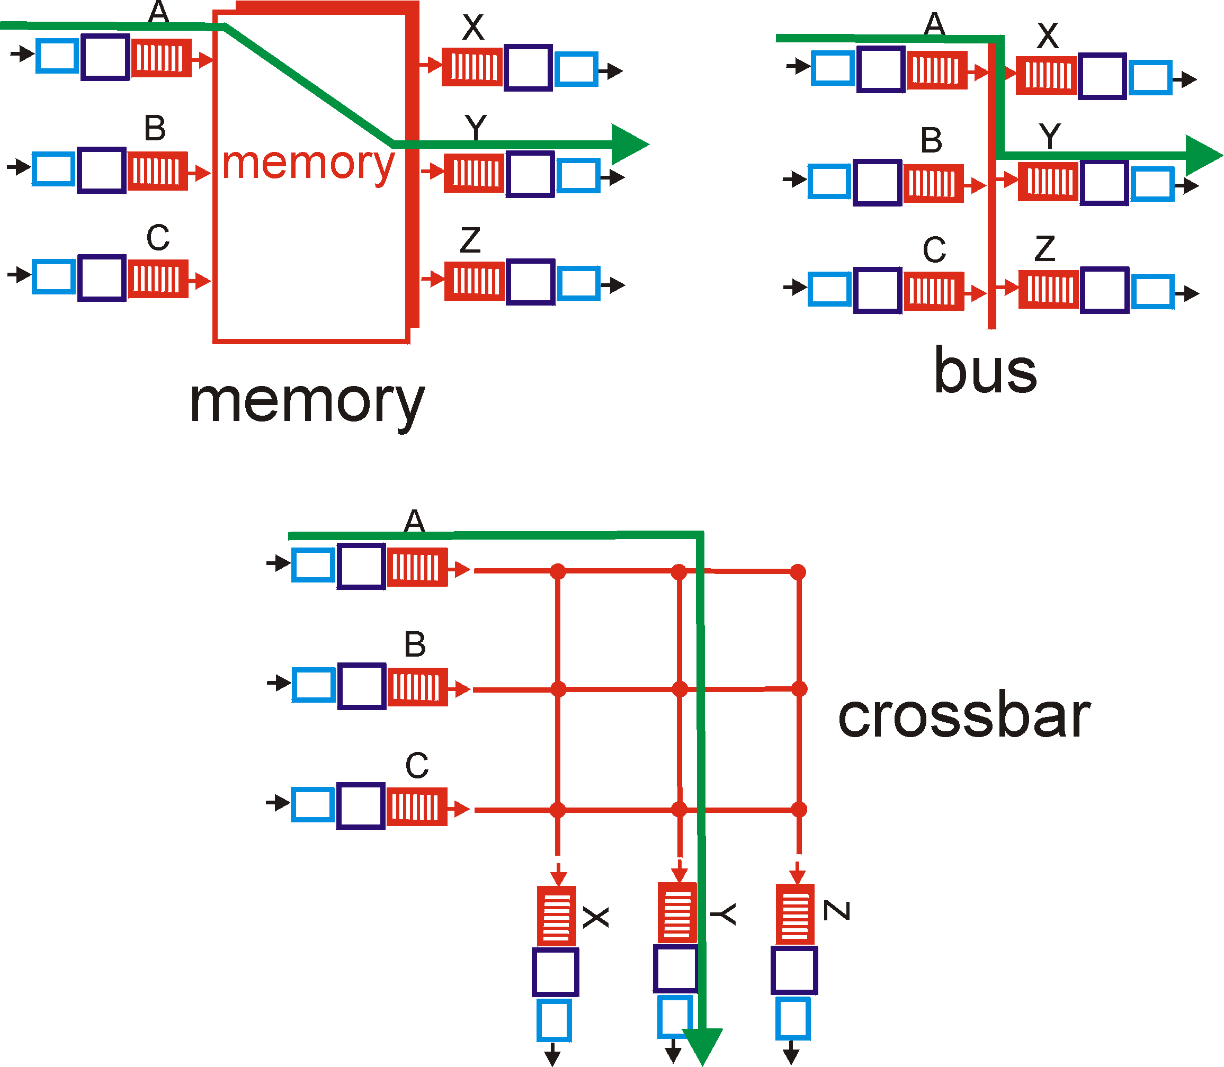
Three Types of Switching Fabrics

Slide 9
Three Types of Switching Fabrics
Switching Via Memory
First generation switches
Speed limited by memory bandwidth (copy 2 times: input → memory → output
Switching Via a Bus
Bus contention: switching speed limited by bus bandwidth
Cisco 5600: 32 Gbps bus
Switching Via a Mesh
Fragmenting datagram into fixed length cells, switch cells through the mesh
Cisco 12000: 60 Gbps throughput

Slide 10
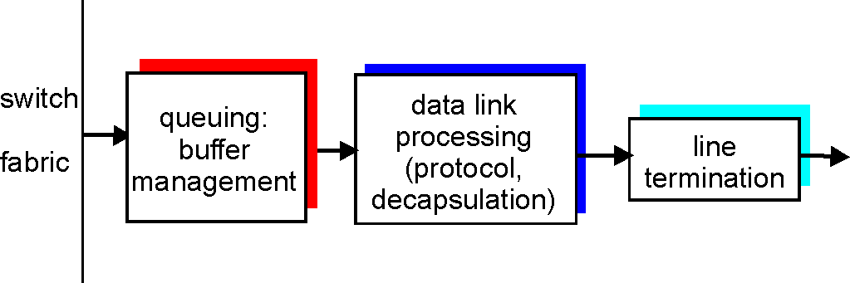
Output Port Functions
Buffering
Required when packets arrive from fabric faster than the transmission rate
Scheduling discipline
Chooses among queued packets for transmission
Select packets to drop when buffer saturates

Slide 11
Network Service
Network service model
Service model for “channel” transporting packets from sender to receiver
Called Quality of Service from host perspective
Example services for individual packets
Guaranteed delivery
Guaranteed delivery with less than 40 msec delay
Example services for a flow of packets
In-order packet delivery
Guaranteed minimum bandwidth to flow
Restrictions on changes in inter-packet spacing

Slide 12
Virtual Circuit and Datagram Networks
Virtual circuit networks
Network service provided on flow of packets
VC network provides network-layer connection oriented service
Datagram networks
Network service provided on singular packet
Datagram network provides network-layer connectionless service

Slide 13
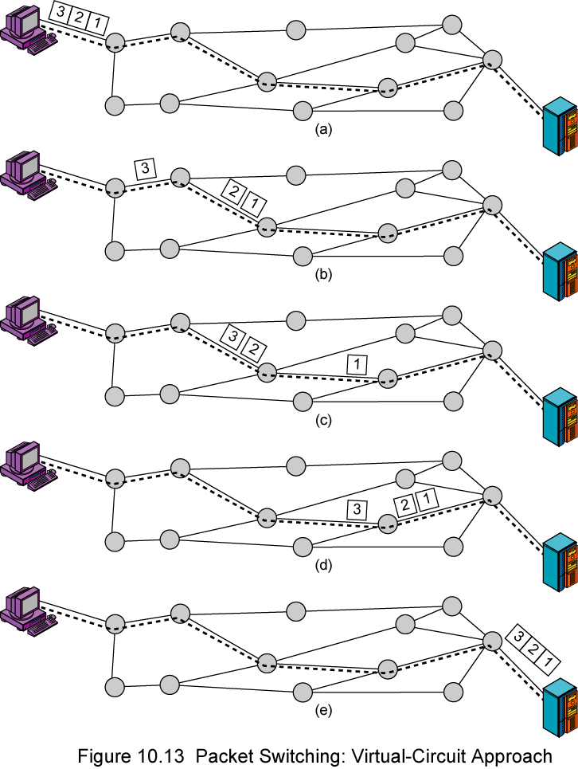
Routing in Virtual Circuit

Slide 14
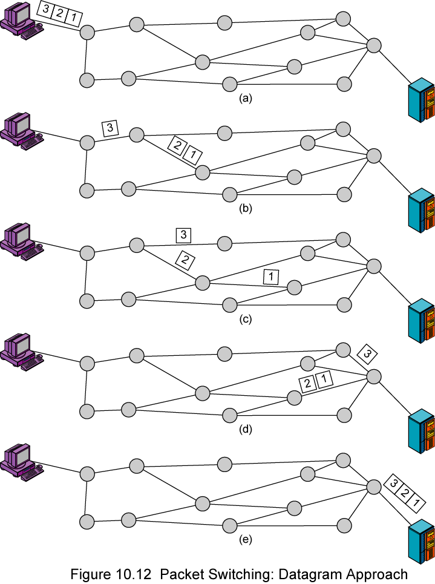
Routing in Datagram Nets

Slide 15
Virtual Circuit Networks
Connection setup, teardown for each flow of packets
Each packet carries VC identifier (not destination host address)
Every switch on source-destination path maintains “state” for each passing connection
Link, switch resources (bandwidth, buffers) may be allocated to VC
Dedicated resources = predictable quality of service

Slide 16
Connection Setup
Essential function for virtual circuit networks
E.g. ATM, frame relay, X.25
Two end hosts and intervening switches pre-establish a path for virtual connection
Routing is used for finding a suitable (shortest) path

Slide 17
VC Implementation
A VC consists of
Path from source to destination
VC numbers, maybe one number for each link along the path
Entries in forwarding tables in switches along the path
Note:
Packet belonging to VC carries VC number (rather than addresses)
VC number can be changed on each link, forwarding table lists the new VC number
Notes:
Other VC No implementations possible: sockets, pair of port addresses for each direction

Slide 18
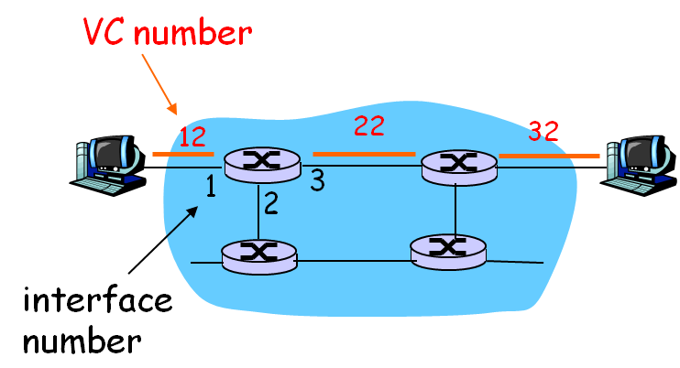
A Forwarding Table for VC
Forwarding table in
northwest switch
Incoming interface Incoming VC # Outgoing interface Outgoing VC #
1 12 3 22
2 63 1 18
3 7 2 17
1 97 3 87
… … … …
Table entries constitutes state information of a VC

Slide 19

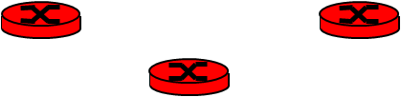
Virtual Circuits: Signaling Protocols
Used to setup, maintain and teardown VC
Used in ATM, frame-relay, X.25
Not used in today’s Internet
application
transport
network
data link
physical
5. Data flow begins
6. Receive data
application
transport
network
data link
physical
4. Call connected
3. Accept call
1. Initiate call
2. incoming call

Slide 20
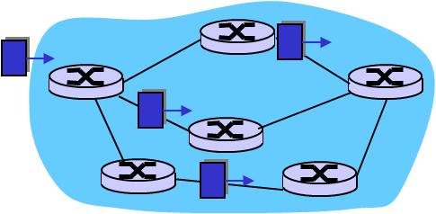
Datagram Networks
No call setup at network layer
No network-level concept of “connection”
Switches: no state about end-to-end connections
Packets forwarded using destination host address
Packets between same source-dest pair may take different paths
application
transport
network
data link
physical
application
transport
network
data link
physical
1. Send data
2. Receive data

Slide 21
A Forwarding Table for Datagram Networks
Also called routing table
May reach 4 billion entries
The destination address prefix may define a switch address or a subnet address
Dest Address Prefix | Address Mask | Link Interface
11001000 00010111 00010 | 11111111 11111111 11111000 00000000 | 0
11001000 00010111 00011000 | 11111111 11111111 11111111 00000000 | 1
11001000 00010111 000110 | 11111111 11111111 11111100 00000000 | 2
default | * | 3

Slide 22
Longest Prefix Matching
Address Prefix Link Interface
11001000 00010111 00010 0
11001000 00010111 00011000 1
11001000 00010111 00011 2
otherwise 3
Examples
DA: 11001000 00010111 00010110 10100001
Which interface?
DA: 11001000 00010111 00011000 10101010
Which interface?

Slide 23
Datagram vs. Virtual Circuit
Datagram (Internet)
Virtual Circuit (ATM)
Data exchange among computers
“Elastic” service, no strict timing
“Smart” end systems (computers)
Can adapt, perform control, error recovery
Simple inside network, complexity at “edge”
Many link types
Uniform service difficult
Evolved from telephony
Human conversation:
Strict timing, reliability requirements
Need guaranteed service
“Dumb” end systems
Telephones
Complexity inside network (switches)
Link type standardized

Slide 24
Routing
Objective
Build routing tables on switches for datagram networks
Choose paths and build forwarding tables when setting up connections for VC networks
Characteristics required
Efficiency: e.g. smallest possible line or switch
Resilience: peak load, switch or line failure
Stability: avoid oscillation

Slide 25
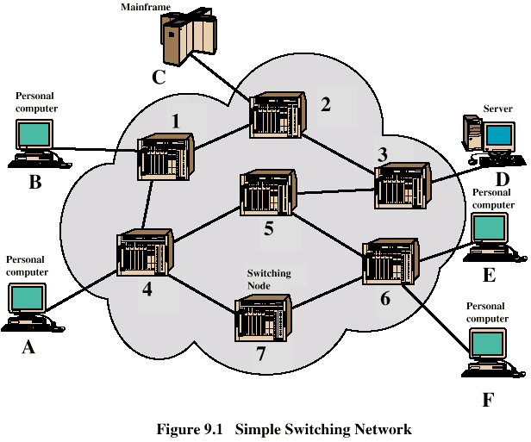
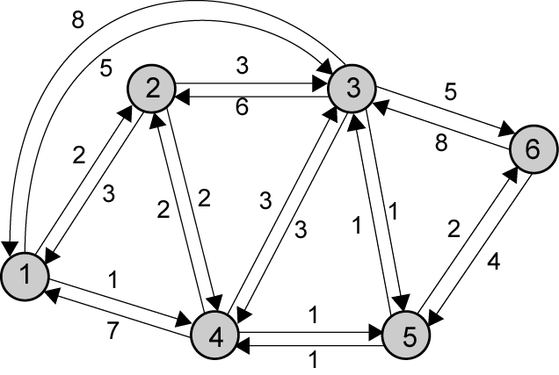
Network Abstraction
Notes:
不完全对应

Slide 26
Routing Elements
Performance criteria
Decision time
Decision place
Network info source
Network info update timing

Slide 27
Performance Criteria
Minimum hop
e.g. 1–3–6
Least cost
e.g. 1–4–5–6
Determine cost
Minimum delay: queue length
Largest throughput: reverse of transmission rate

Slide 28
Decision Time and Place
Time
For each packet --- datagram networks
At the start of each virtual circuit --- VC networks
Place
Centralized
Source --- source routing
Distributed --- by each switch node

Slide 29
Network Info Source and Update Timing
Info source
Local information
Adjacent switches
All switches in the network
Update timing
Update periodically
Upon major changes in switches or links
Fixed (manual configuration)

Slide 30
Different Routing Strategies
Central (static)
Fixed and configured
Distributed
Flooding
Random
Adaptive

Slide 31
Central Routing
Single fixed route for each source to destination pair
Determine routes using a least cost algorithm
Routes re-config upon major changes in network topology

Slide 32
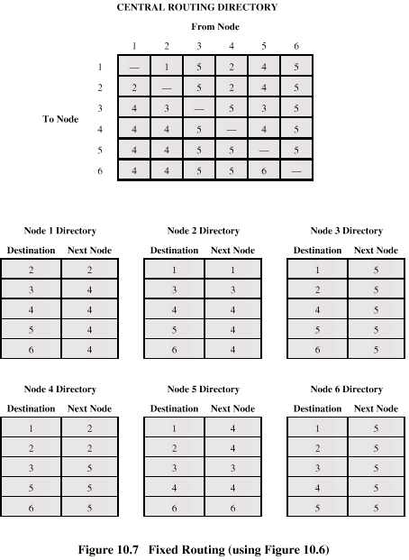
Fixed Routing Tables
1
6
Centralized
Distributed

Slide 33
Flooding
No network info required
Packet sent by switch to every neighbor
Packets retransmitted on every link except incoming link
Eventually a number of copies will arrive at destination
Duplicates
Many copies of the same packet is created
Cycle problem
These copies may circling around the network forever
A hop count in packets can handle the problem
Notes:
路由器记录转发分组存在问题：
需要较大的存储空间
每次转发需要查询，增加转发延迟

Slide 34
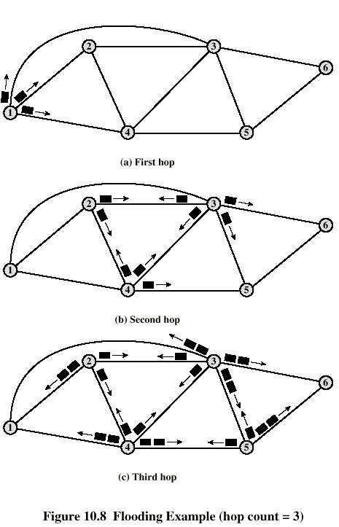
Flooding Example
Hop count = 3
Initial
3 packets
1st hop
9 packets
2nd hop
23 packets
Notes:
未记录已转发分组，优点：
尝试所有路径
节省switch资源，问题：
需hop count

Slide 35
Properties of Flooding
All possible routes are tried
Very robust
At least one packet will take minimum cost route
Can be used to set up virtual circuit
All switches are visited
Useful to distribute information (e.g. routing)

Slide 36
Random Routing
Node selects one outgoing path for retransmission of incoming packet
Selection can be random or round robin
Or based on probability calculation
No network info needed
Suitable for strongly-connected network
Route is typically not optimal

Slide 37
Assign Probabilities
P_{i} = R_{i} / Σ_{j}R_{j}
P_{i} – Probability of selecting out-link i
R_{i} – Cost factor of link i
Possible cost factor
Transmission rate – for throughput
Reverse of queue size – for delay

Slide 38
Adaptive Routing
Used by almost all packet switching networks
Routing decisions change as conditions on the network change
Requires info about network
Tradeoff between quality of network info and overhead
Aid in congestion control

Slide 39
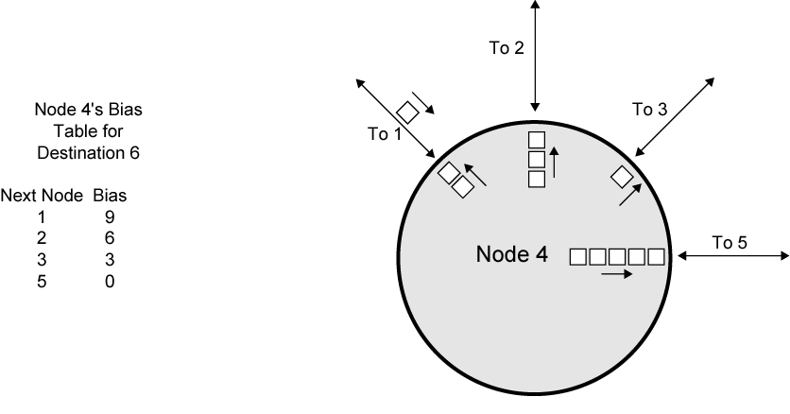
An Isolated Adaptive Routing
Only local info used
=9
=4
=5

Slide 40
2 Least Cost Algorithms
For each pair of nodes, find a path with the least cost
Dijkstra’s Algorithm
Bellman-Ford Algorithm

Slide 41
Dijkstra’s Algorithm
Find shortest paths from given source to all other nodes
Developing paths in order of increasing path cost (length)
Denote
N = set of nodes in the network
s = the source node
T = set of nodes so far incorporated by the algorithm
w(i, j) = link cost from node i to node j
w(i, i) = 0
w(i, j) = ∞ if the two nodes are not directly connected
w(i, j) > 0 if the two nodes are directly connected
Notes:
按树的生长计算

Slide 42
Dijkstra’s Algorithm Method
L(n) = cost of least-cost path from source s to node n currently known
At termination, L(n) is cost of least-cost path from s to n
Step 1 [Initialization]
T = {s} set of nodes incorporated consists of only source node
L(n) = w(s, n) for n ≠ s
Initial path costs to neighboring nodes are simply link costs
Step 2 [Get Next Node]
Find node x not in T with least-cost path from s (i.e. min L(x))
Incorporate node x into T
Also incorporate the edge that links x with the node in T that contributes to the path

Slide 43
Dijkstra’s Algorithm Method
Step 3 [Update Least-Cost Paths]
L(n) = min[L(n), L(x) + w(x, n)] for all n ∉ T
If latter term is minimum, path from s to n is path from s to x concatenated with link from x to n
Algorithm terminates when all nodes have been added to T

Slide 44
Dijkstra’s Algorithm Notes
One iteration of steps 2 and 3 adds one new node to T
Defines least cost path from s to that node
Value L(n) for each node n is the cost (length) of least-cost path from s to n
At last, T defines the least-cost path from s to each other node

Slide 45
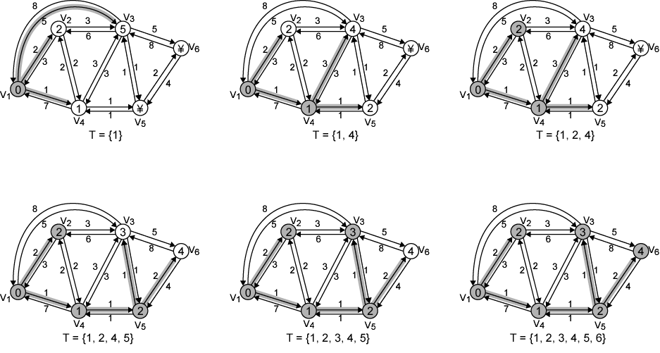
Example of Dijkstra's Algorithm

Slide 46
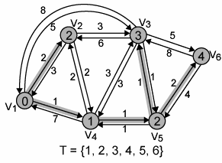
Results of Example Dijkstra’s Algorithm
No | T | L(2) | Path | L(3) | Path | L(4) | Path | L(5) | Path | L(6) | Path
1 | {1} | 2 | 1-2 | 5 | 1-3 | 1 | 1-4 | ∞ | – | ∞ | –
2 | {1,4} | 2 | 1-2 | 4 | 1-4-3 | 1 | 1-4 | 2 | 1-4-5 | ∞ | –
3 | {1, 2, 4} | 2 | 1-2 | 4 | 1-4-3 | 1 | 1-4 | 2 | 1-4-5 | ∞ | –
4 | {1, 2, 4, 5} | 2 | 1-2 | 3 | 1-4-5-3 | 1 | 1-4 | 2 | 1-4-5 | 4 | 1-4-5-6
5 | {1, 2, 3, 4, 5} | 2 | 1-2 | 3 | 1-4-5-3 | 1 | 1-4 | 2 | 1-4-5 | 4 | 1-4-5-6
6 | {1, 2, 3, 4, 5, 6} | 2 | 1-2 | 3 | 1-4-5-3 | 1 | 1-4 | 2 | 1-4-5 | 4 | 1-4-5-6
Destination | Next-Hop | Distance
2 | 2 | 2
3 | 4 | 3
4 | 4 | 1
5 | 4 | 2
6 | 4 | 4

Slide 47
Bellman-Ford Algorithm
Find shortest paths from given node containing at most 1 link
Find the shortest paths that containing at most 2 links, based on the result of 1 link
Find the shortest paths of 3 links based on result of 2 links, and so on
s = the source node
w(i, j) = link cost from node i to node j
w(i, i) = 0
w(i, j) = ∞ if the two nodes are not directly connected
w(i, j) > 0 if the two nodes are directly connected
Notes:
当前为i，则最短路径长度不大于i者都已确定

Slide 48
Bellman-Ford Algorithm Method
h = maximum number of links in path at current stage of the algorithm
L_{h}(n) = cost of least-cost path from s to n under constraint of no more than h links
Step 1 [Initialization]
L₀(n) = ∞, for all n ≠ s
L₁(n) = w(s, n)
L_{h}(s) = 0, for all h

Slide 49
Bellman-Ford Algorithm Method
Step 2 [Update]
For each successive h > 0
For each n ≠ s, compute L_{h+1}(n) = min_{j}[L_{h}(j)+w(j,n)]
Connect n with predecessor node j that achieves minimum
Eliminate any connection of n with different predecessor formed during earlier iterations
Repeat until no change made to route (convergence)

Slide 50
Bellman-Ford Algorithm Notes
For each iteration with h and for each destination node n
Compares newly computed path from s to n of length h with path from previous iteration (h−1)
If previous path shorter it is retained
Otherwise new path is defined

Slide 51
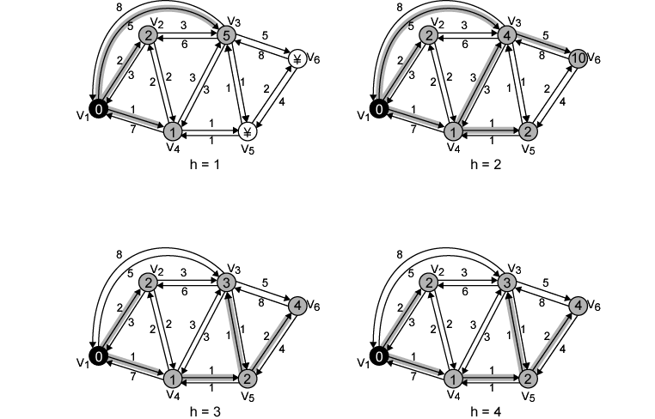
Example of Bellman-Ford Algorithm
Notes:
最大2条边

Slide 52
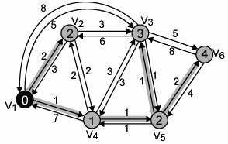
Results of Bellman-Ford Example
h | L_{h}(2) | Path | L_{h}(3) | Path | L_{h}(4) | Path | L_{h}(5) | Path | L_{h}(6) | Path
0 | ∞ | – | ∞ | – | ∞ | – | ∞ | – | ∞ | –
1 | 2 | 1-2 | 5 | 1-3 | 1 | 1-4 | ∞ | – | ∞ | –
2 | 2 | 1-2 | 4 | 1-4-3 | 1 | 1-4 | 2 | 1-4-5 | 10 | 1-3-6
3 | 2 | 1-2 | 3 | 1-4-5-3 | 1 | 1-4 | 2 | 1-4-5 | 4 | 1-4-5-6
4 | 2 | 1-2 | 3 | 1-4-5-3 | 1 | 1-4 | 2 | 1-4-5 | 4 | 1-4-5-6
Destination | Next-Hop | Distance
2 | 2 | 2
3 | 4 | 3
4 | 4 | 1
5 | 4 | 2
6 | 4 | 4

Slide 53
Dijkstra vs. Bellman-Ford
Routing based on Dijkstra
Link states flood to all other nodes
Each node will have complete topology and build its own routing table
Routing based on Bellman-Ford
Each node maintain distance vectors to other known nodes
Vectors exchanged with direct neighbours to update the paths and costs
Routing tables built in a distributed way

Slide 54
Dijkstra vs. Bellman-Ford
Message complexity
DK: n nodes, e links, O(ne) messages
BF: Depends on convergence time
Speed of convergence
DK: O(n²) and quick; May have oscillations
BF: Slow and depends on changes; May contain routing loops
Robustness: what happens if node malfunctions
DK: Advertise incorrect direct links cost; Error range constrained
BF: Error node can exchange incorrect paths cost; Error may propagate through the network

Slide 55
Determine Link Cost
3 stages in ARPANET
First stage in 1969
Output queue length is used to define a link cost
Bellman-Ford algorithm is used for routing
Second stage in 1979
Measured delay is used to define a link cost
Mix queuing, transmission, and propagation
Time of retransmit – Time of arrive + Transmission time + Propagation time
Dijkstra’s algorithm is used for routing
Notes:
1st stage: only T1 line used

Slide 56
Determine Link Cost
To handle the oscillation problem of Dijkstra
Let some stay on loaded links to balance the traffic
Apply Link utilization to represent a link’s state
Leveling based on previous value and new utilization
Use hop normalized metric to calculate link cost

Slide 57
Calculate Link Cost
Uses the single-server queuing model
Link utilization
ρ =2(Ts − T)/(Ts − 2T)
T – current measured delay
Ts – mean packet length (600 bit) / transmission rate of the link
Leveling
U_{n} = α×ρ_{n}+(1–α)×U_{n–1}
U_{n} – leveled link utilization at time n
α – constant, now set 0.5

Slide 58
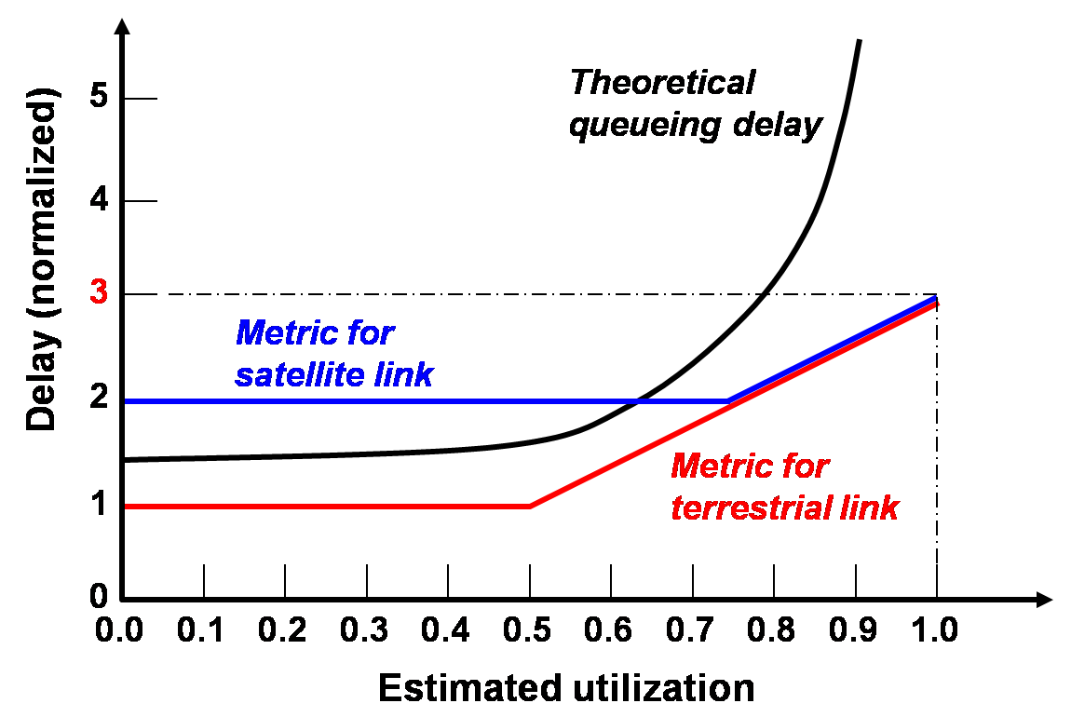
Calculate Link Cost
Set link cost based on leveled utilization

Slide 59
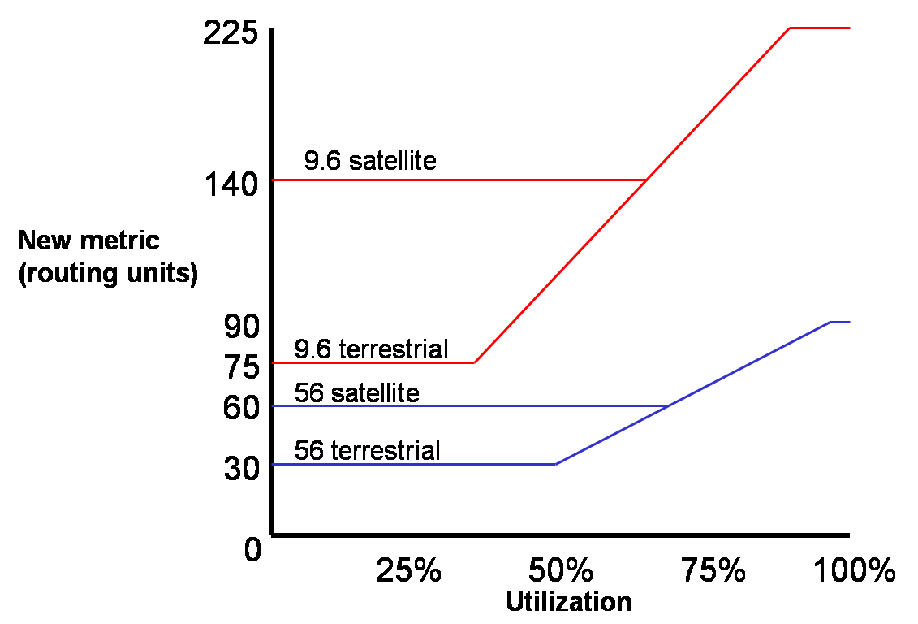
Link Utilization to Cost

Slide 60
ATM and Cell Switching
ATM: Asynchronous Transfer Mode
1990’s/2000 standard for high-speed Broadband Integrated Service Digital Network (ISDN) architecture
155Mbps to 622 Mbps and higher
Features
Meeting timing/QoS requirements of voice and video, also support “burst” data
“Next generation” telephony: technical roots in telephone world
Packet-switching (fixed length packets, called “cells”) using virtual circuits

Slide 61
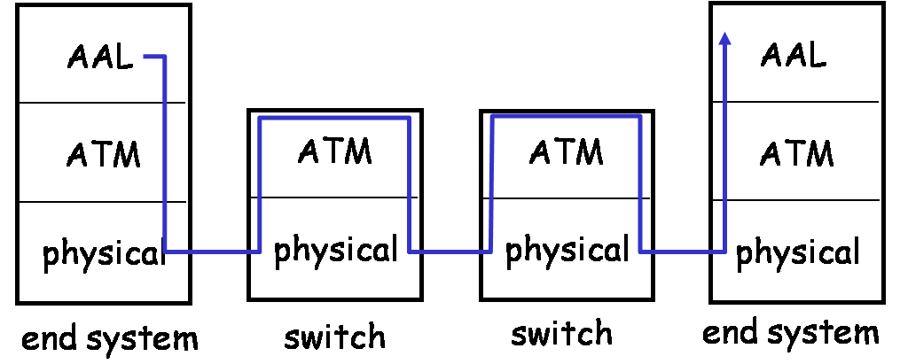
ATM Architecture
Adaptation layer: only at edge of ATM network
Data segmentation/reassembly, different service models
Roughly analogous to Internet transport layer
ATM layer: “network” layer
Cell switching, routing
Physical layer: SDH/SONET

Slide 62
ATM Adaptation Layer
ATM Adaptation Layer (AAL)
“Adapts” upper layers (IP or native ATM applications) to ATM layer below
Present only in end systems, not in switches
Different types of AALs
AAL1, Constant Bit Rate (CBR), e.g. circuit emulation
AAL2, Variable Bit Rate (VBR), e.g. voice and vedio
AAL3/4, Connection-oriented data service, e.g. X.25 and Frame Relay
AAL5, Connectionless data service, e.g IP datagram
Notes:
The latter 2 are mixed, i.e. each can support the other

Slide 63
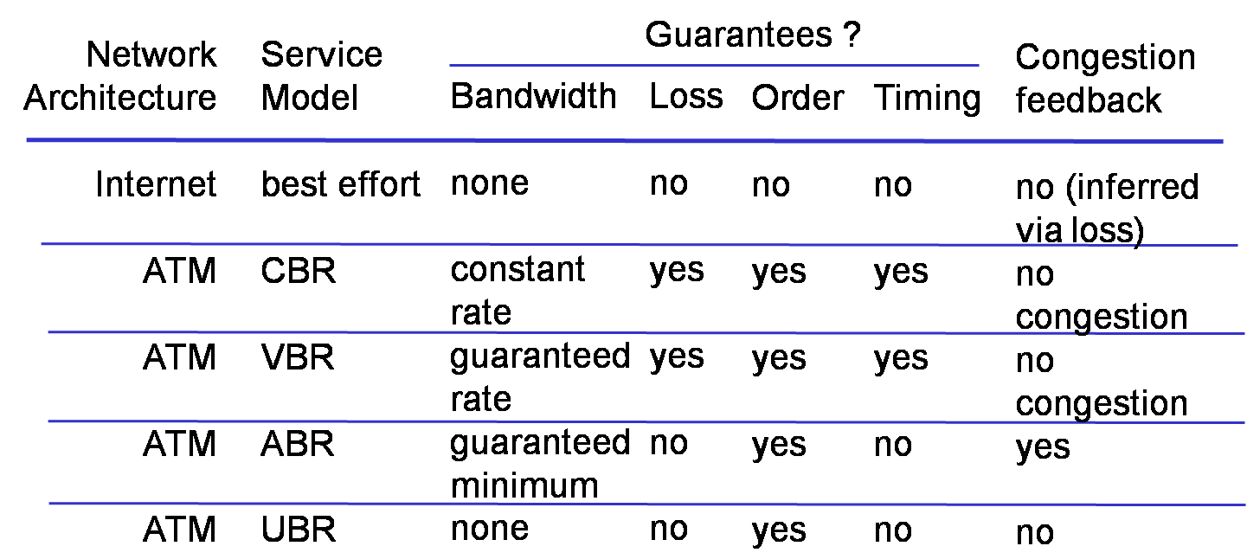
ATM Services
In decreasing priority
CBR and VBR
Available Bit Rate (ABR) and Unspecified Bit Rate (UBR)

Slide 64
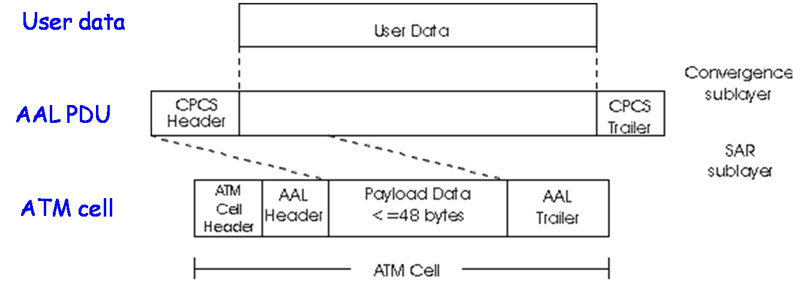
AAL Frames
AAL layer frame
Header + data + trailer, specific in each AAL type
Fragmented across multiple ATM cells
Notes:
Common Part Convergence Sublayer (CPCS)
Segmentation and Reassembly (SAR)

Slide 65
ATM Layer: Virtual Circuits
VC transport: cells carried on VC from source to destination
Permanent VCs (PVC)
Long lasting connections
Switched VCs (SVC)
Dynamically set up on per-connection basis
A VC consists of virtual paths and virtual channels
Virtual Path Identifier (VPI) + Virtual Channel Identifier (VCI)
Notes:
Support multiplexing

Slide 66
ATM VCs
Advantages of ATM VC approach
QoS performance guarantee for data communication on VC
Bandwidth, delay, delay jitter
Drawbacks of ATM VC approach
Inefficient support of Internet datagram traffic
One VC for each IP packet: introduces call setup latency and processing overhead
Better: one VC for a flow of IP packets

Slide 67
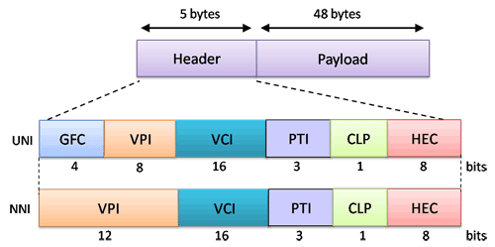
ATM Cells
5 octet header + 48 octet payload
Small payload → short cell-creation delay and switching delay
48 = halfway between 32 and 64 (a compromise)
NNI (Network-Network Interface)
UNI (User-Network Interface)
Notes:
Most ATM links use UNI cell format

Slide 68
ATM Cell Header
GFC: Generic Flow Control
0 by default, local flow control bits
VPI/VCI: virtual circuit ID
Will change from link to link thru net
PT: Payload type
E.g. “Operation Administration and Maintenance” cell or data cell
CLP: Cell Loss Priority bit
CLP = 1 implies low priority cell, can be discarded if congestion
HEC: Header Error Checksum (cyclic redundancy check)

Slide 69
ATM Physical Layer
2 sublayers
Transmission Convergence sublayer
Physical Medium Dependent sublayer: depends on physical medium being used
TC sublayer functions
Header checksum generation: 8 bits CRC
Cell delineation to signal representation
Transmission of idle cells when no data cells to send

Slide 70
Physical Medium Dependent Sublayer
SONET/SDH: transmission frame structure
Bit synchronization
Bandwidth partitions (TDM)
Multiple speeds: OC3 = 155.52 Mbps; OC12 = 622.08 Mbps; OC48 = 2.45 Gbps, OC192 = 9.6 Gbps
TI/T3: transmission frame structure
Low speed line: 1.5 Mbps/ 45 Mbps
Unstructured: just cells (busy/idle)

Slide 71
X.25 and Frame Relay
X.25
A packet-switching wide area network developed by ITU-T in 1976
Defines how a packet-mode terminal can be connected to a packet network
Known as a subscriber network interface (SNI) protocol
Frame Relay
Packet-switching with virtual-circuit technology
An enhancement of X.25, due to improved transmission media
Interconnect LANs, instead of terminals

Slide 72
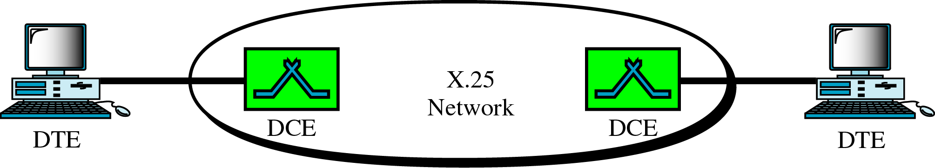
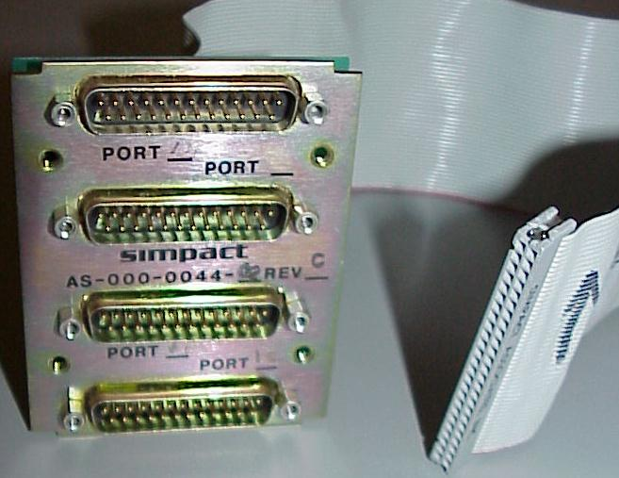
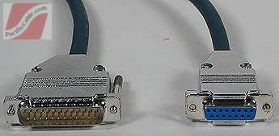
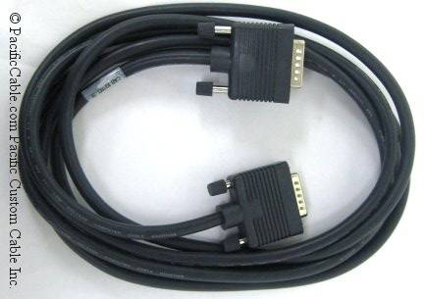
X.25
Defines how a user’s DTE communicates with a packet switching network (DCE)
Defines how packets are sent thru the virtual circuit established between DTEs
Notes:
Data Terminal Equipment
Data Communications Equipment

Slide 73
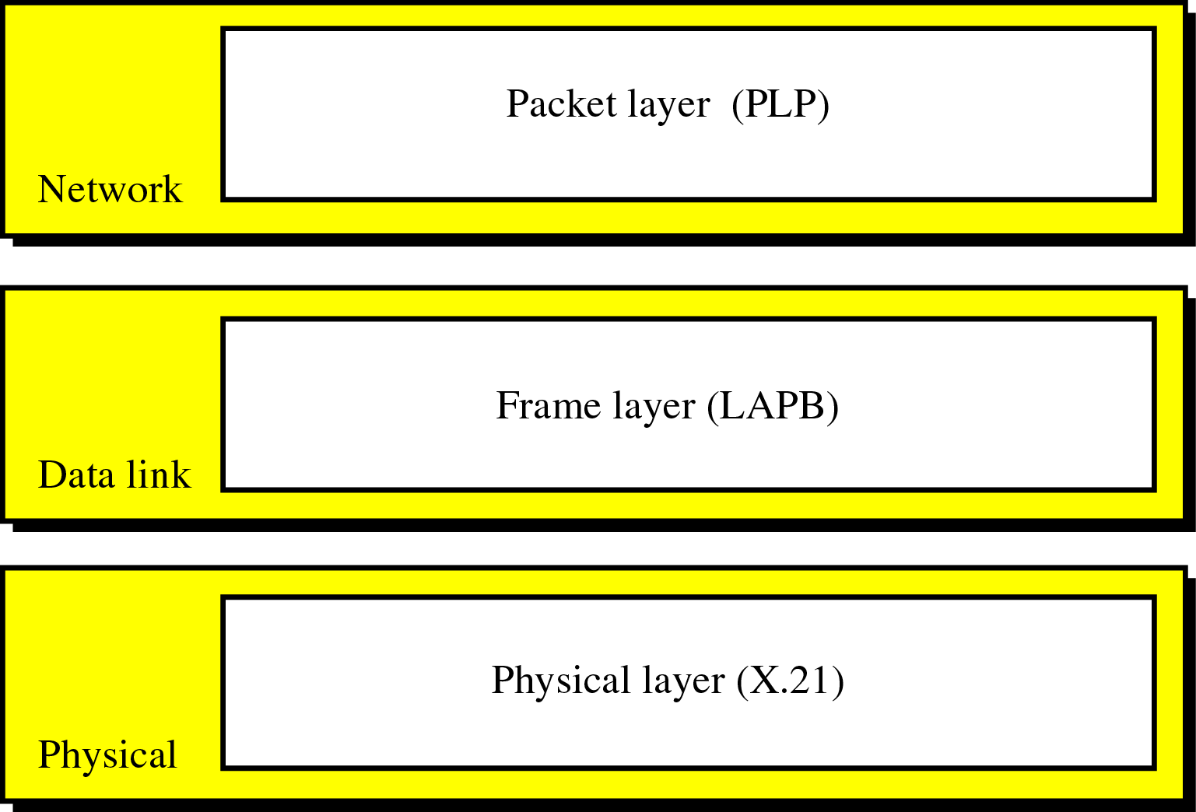
X.25 Layers
Link Access Procedure, Balanced
Notes:
PLP: Packet Layer Protocol

Slide 74
The Physical Layer
Specify the physical interface between DTC and DCE
Signaling on the link that connected the X.25 network
Can provide synchronous data transmission at rates from 100 kbps to 10 Mbps
Capable of running full-duplex data transmissions

Slide 75
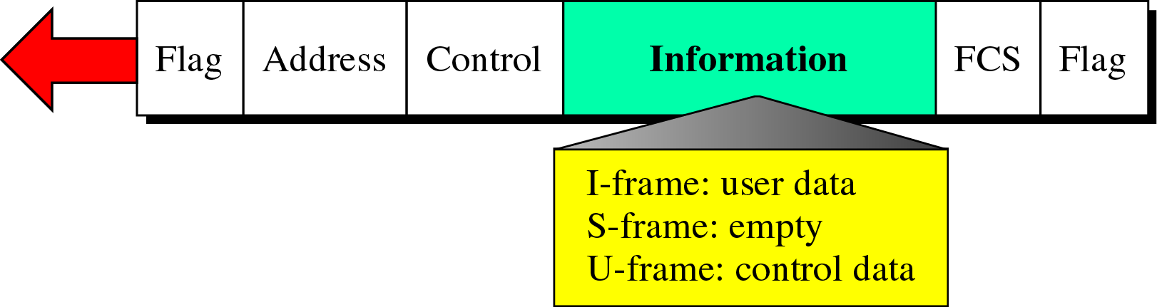
Frame Layer
Link access procedure, balanced (LAPB) protocol
Reliable data transfer: error and flow control
Link Setup; Packet Transfer; Link Disconnect
3 types of frames
I-Frames: data frame
S-Frames: flow and error control
U-Frames: setup and disconnect links between DTE and DCE
Notes:
Link-level connection

Slide 76
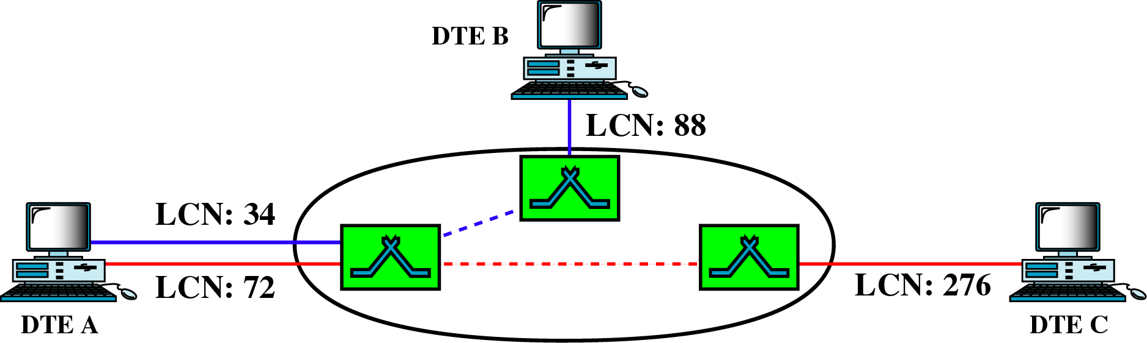
Packet Layer
Packet Layer Protocol (PLP)
Establish connection, transfer data, and terminate connection between 2 DTEs
Create virtual circuits and negotiate network services between DTEs
Virtual circuits in X.25
2 types: permanent VC, switched VC
Identified by logical channel number (LCN)

Slide 77
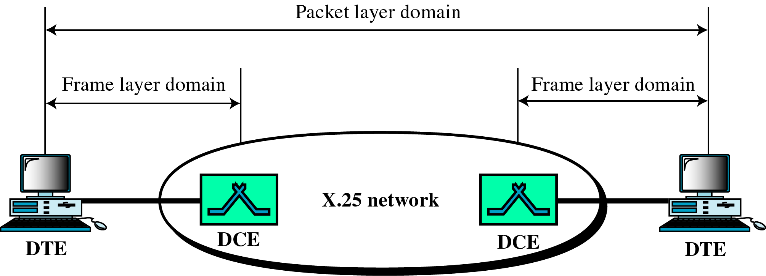
Connection Events in X.25
Setup links between DCE and DTE pairs
Establish VC between DTEs
Transfer data
Release the VC
Disconnect the links

Slide 78
Frame Relay
Improvement of X.25, taking advantage of high-speed new links with lower error-rates
Operate only at the Physical and Data link layer
Not provide error checking or require ACK in data link layer
Layers in FR
Physical layer, any protocols recognized by ANSI, up to 44.376 Mbps
Data link layer, a simplified version of HDLC called core LAPF, no error and flow control fields
Notes:
ANSI: American National Standards Institute
LAPF: Link Access Procedure for Frame Mode Services

Slide 79
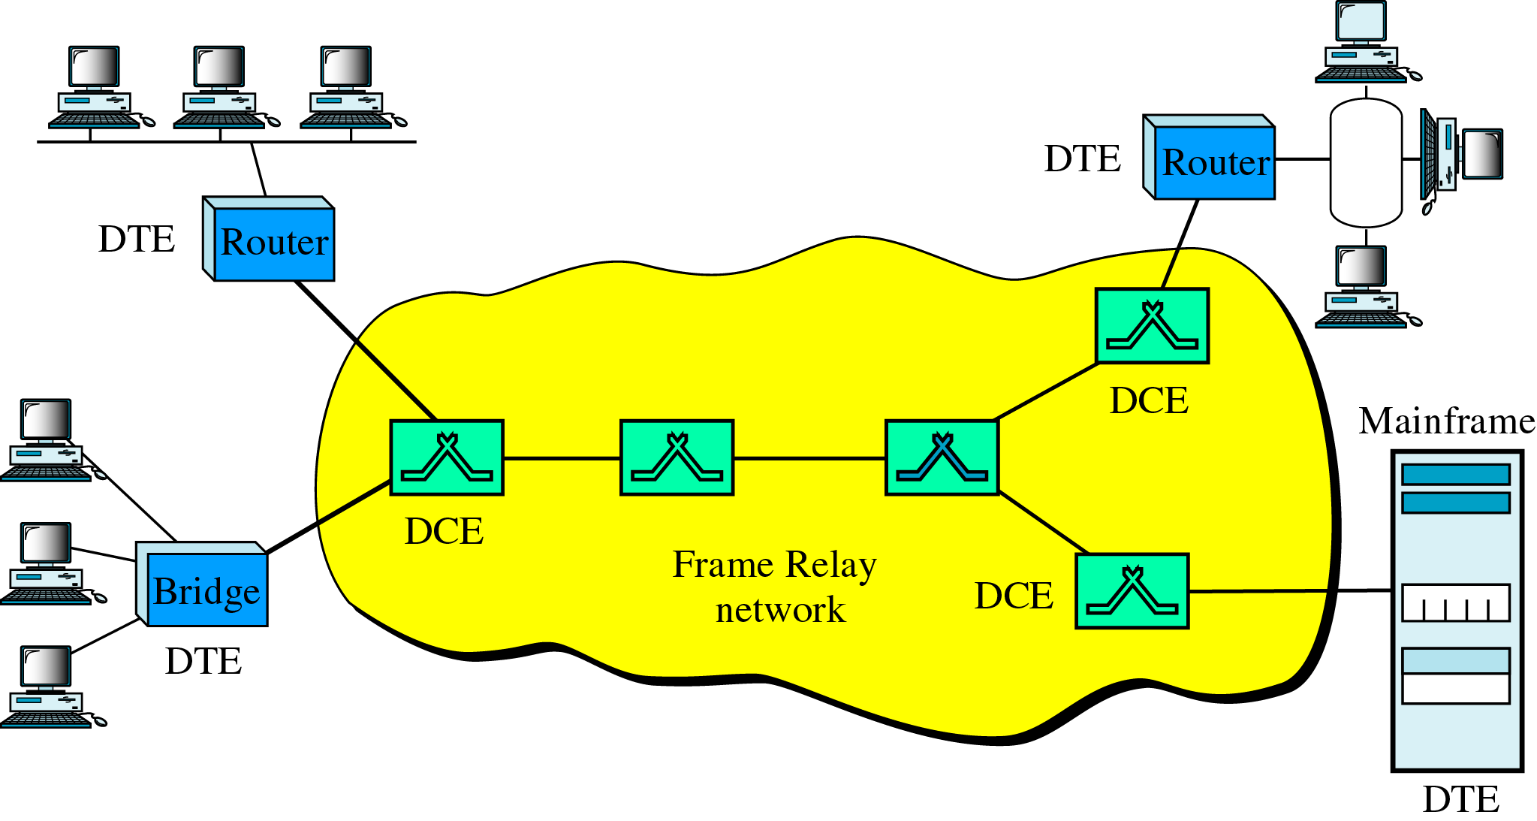
A Frame Relay Network

Slide 80
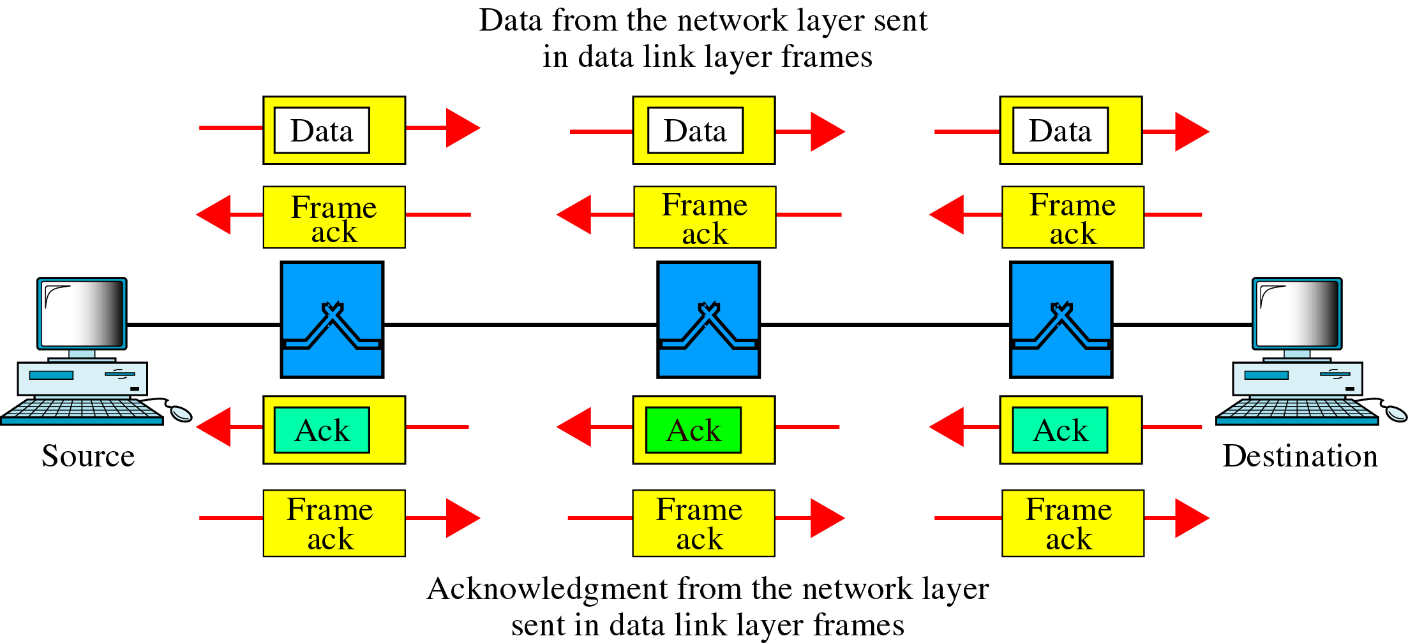
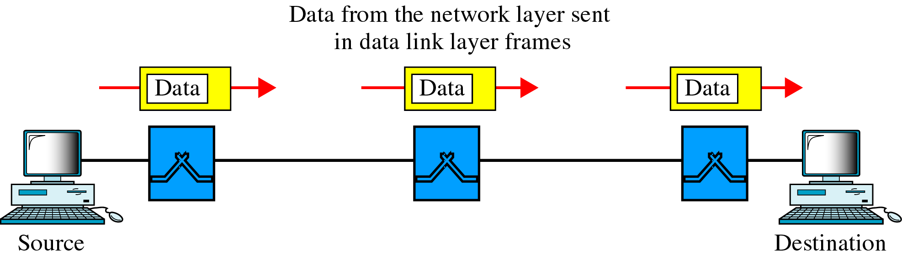
X.25 vs. Frame Relay

Slide 81
Virtual Circuits in FR
Also provide PVC and SVC connections
A VC is identified by a Data Link Connection Identifier (DLCI)
2 DLCIs are given for each end of the connection
DLCI is assigned to the DTEs when the VC is established
Serve as addresses of the DTEs
Not changed on DCEs

Slide 82
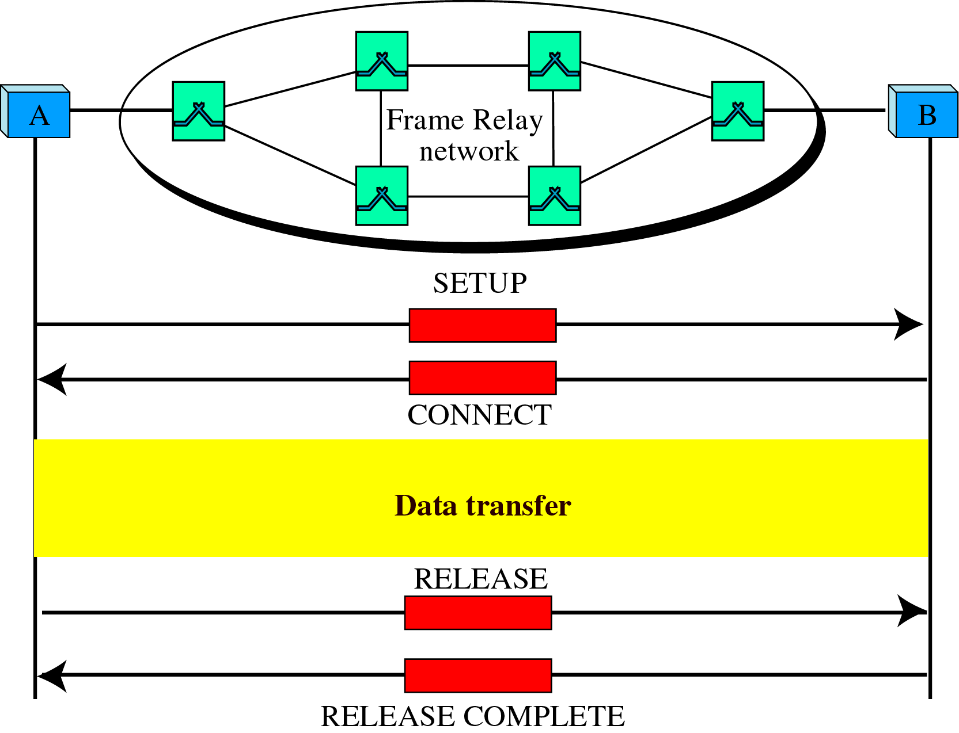
SVC Setup and Release

Slide 83
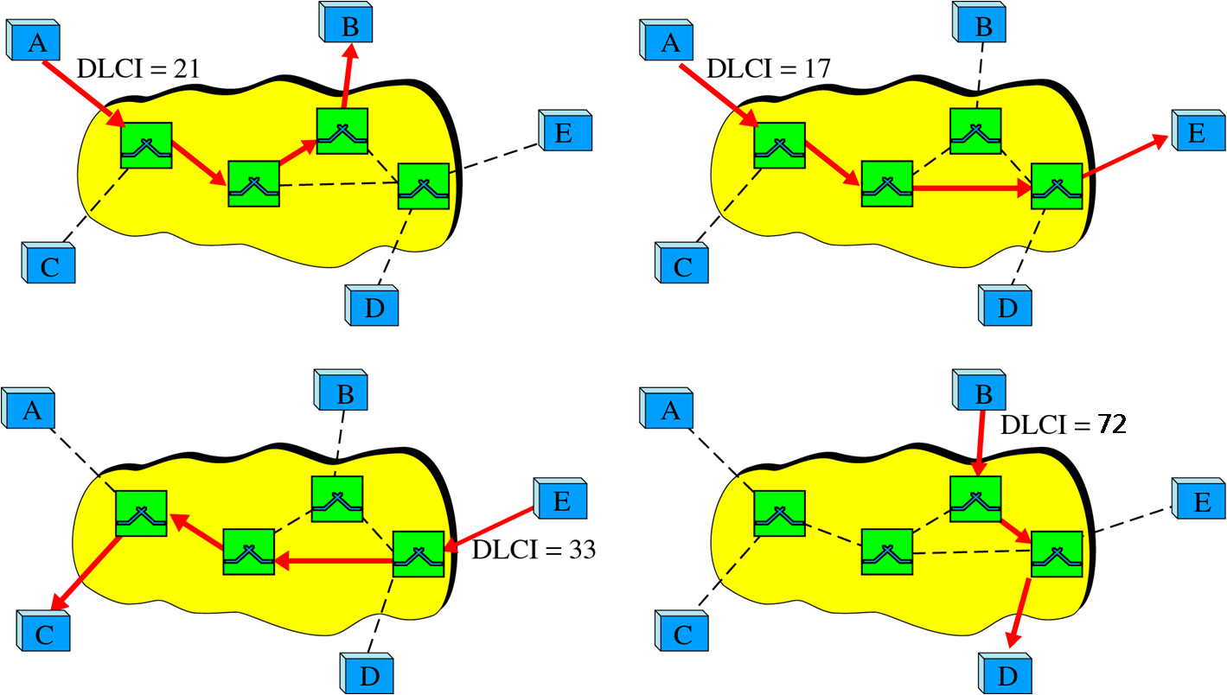
DLCIs in FR Networks
Notes:
Data Link Connection Identifier: changed at border DCEs

Slide 84
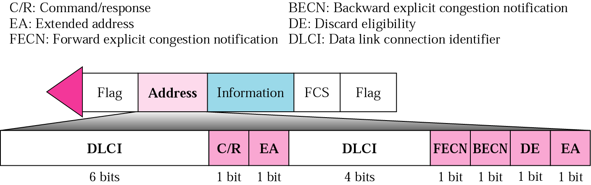
FR Frame Structure
Notes:
Address field may be longer than 2 octets, depending on the EA bits

Slide 85
Chapter Goals
Understand principles behind packet switching networks
Network layer service models
Routing algorithms
Virtual circuits
Instantiation of packet switching networks
X.25 and FR
ATM

